Slide 1
Strategy & Tactics

Slide 2
Overview
Introduction
Formation Motion
Waypoint Tactics
Tactical Analysis
Tactical Pathfinding
References

Slide 3
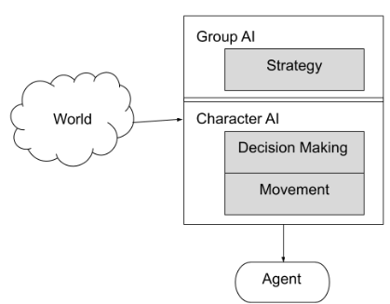
Group AI

Slide 4
Strategy vs Tactics
Strategy:
General plan to achieve a goal (long time).
Example: Planning where to send the troops to win the war.
Tactics:
Specific plan to achieve a particular goal (part of a strategy).
Example: How soldiers should run in a zig-zag pattern to decrease the chance of being shot.
Source: Diffen (Strategy vs Tactic)

Slide 5
Overview
Introduction
Formation Motion
Waypoint Tactics
Tactical Analysis
Tactical Pathfinding
References

Slide 6

Fixed Formations
For simple formations.
Formation: set of slots
Slot: location for an agent
1 slot leader
rest of slots follow the leader
s: slot l: leader
p: position
Ω: orientation
r: position to leader
ω: orientation to leader
Example:
video / code* Other formations may require the rotation of the followers!
Variants:
Scalable Formations
Depends on the number of members.
Example: defensive circles
Emergent Formations
Not all the members follow the leader (cascade)
Example: wedge formation
generated by hilite

Slide 7
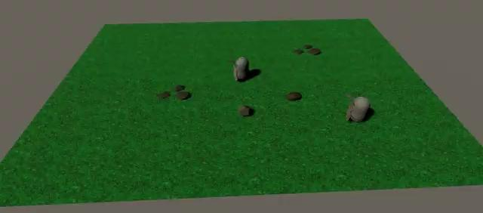

Slide 8

Slot Roles & Assignment I
Slot Roles are the typical RPG formations, in which every layer has a role:
Melee warriors
Arquers and Missile Magicians
Magic and Healers
They might need rearguard layers.
Approach 1: fixed slots
Given a fixed slot structure, an assignment of units has to be given:
Cost | Magic | Missile | Melee
Ranger | 1000 | 0 | 500
Warrior | 2000 | 1000 | 0
Mage | 500 | 0 | 2000
Healer | 0 | 1000 | 2000
Optimization process
Genetic Algorithm
Fitness:

Slide 9
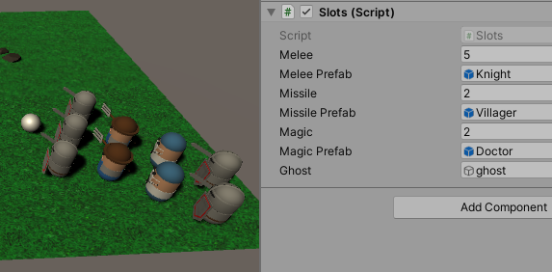
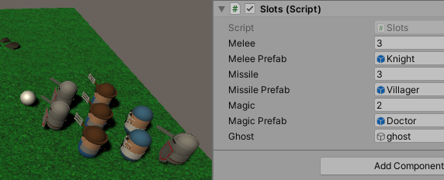
Slot Roles & Assignment II
Approach 2: dynamic slots
Given a set of units, build a proper slot structure.
Spawner* / download
Follower* / download

Slide 10

Slot Roles & Assignment II

Slide 11
Overview
Introduction
Formation Motion
Waypoint Tactics
Tactical Analysis
Tactical Pathfinding
References

Slide 12
Tactical Locations
Tactical locations or waypoints:
defensive locations, cover points, shadows...
A location can be a compound tactic: set of primitive tactics Example: cover / shadow
Using tactical locations:
Previous algorithms: FSM, BTs, GOAP...
Generation of properties:
Manually: level designer
Automatic: raycast (visibility, cover), light maps (shadow)...
Generation of waypoints:
Watching human players
Waypoint Grids: test possible locations and choose the bests

Slide 13
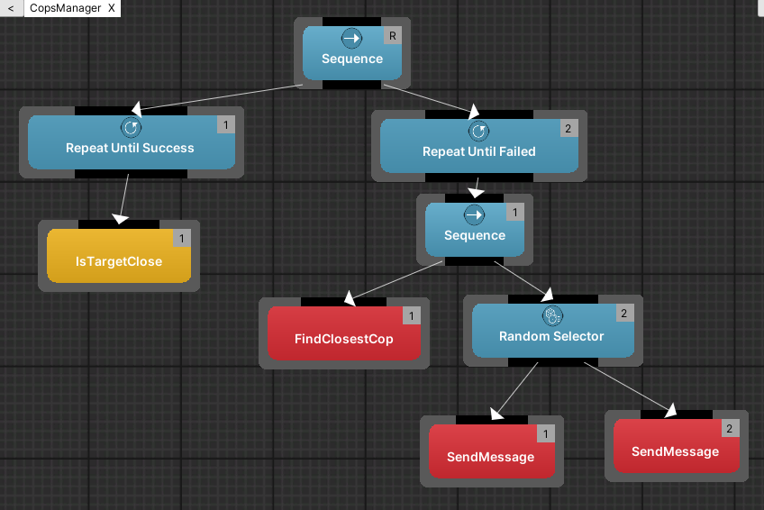
Example: BT for Cops Manager
Video
IsRobberNear?* / download
Find Closest Cop* / download
Cop* / download

Slide 14
Overview
Introduction
Formation Motion
Waypoint Tactics
Tactical Analysis
Influence maps
Terrain Analysis
Tactical Pathfinding
References

Slide 15

Brief History
Track of current military influence of each location.
Influence:
Applications:
Safe areas, areas to avoid, weakest border...
Plan attack locations or movement guide
Dealing with unknowns:
Risk of underestimating forces (fog-of-war)
Prediction of the enemy forces (Machine Learning)

Slide 16
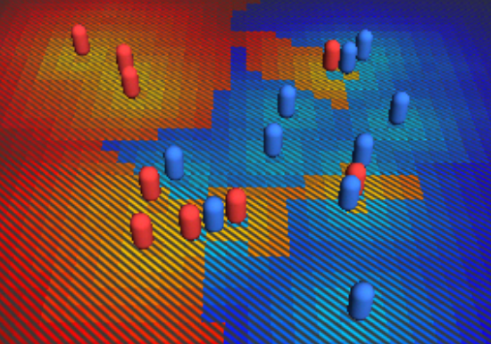
Example
Influence maps by Anomalous Underdog
Video / Reference

Slide 17
Overview
Introduction
Formation Motion
Waypoint Tactics
Tactical Analysis
Influence maps
Terrain Analysis
Tactical Pathfinding
References

Slide 18
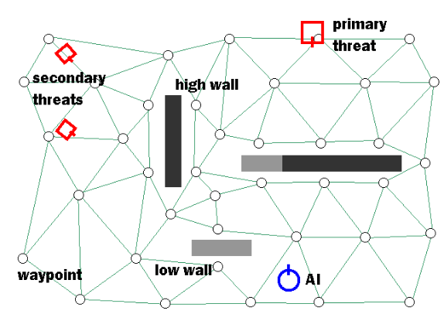
Game AI Properties
Extracting useful data from the structure of the landscape.
Covers, shadows, visibility...
Algorithm: visite locations, calculate and annotate.
Situations may change fast and they can have a high cost.
Example:
Killzone's AI: dynamic procedural combat tactics
Initial situation (with legends)

Slide 19
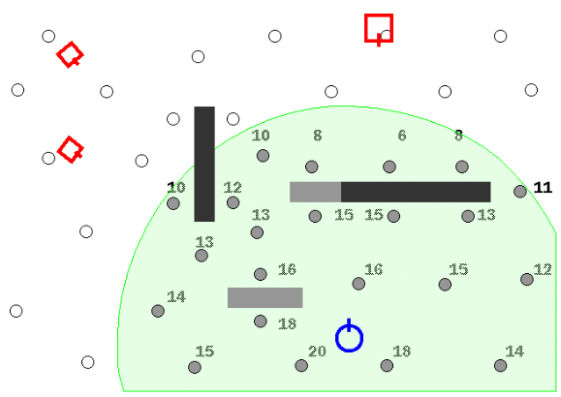
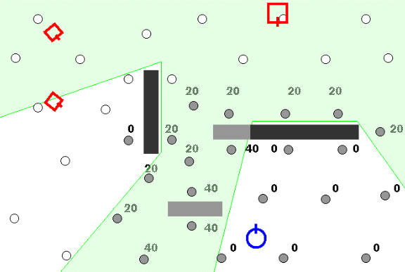
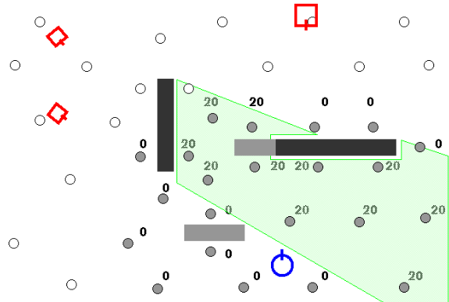
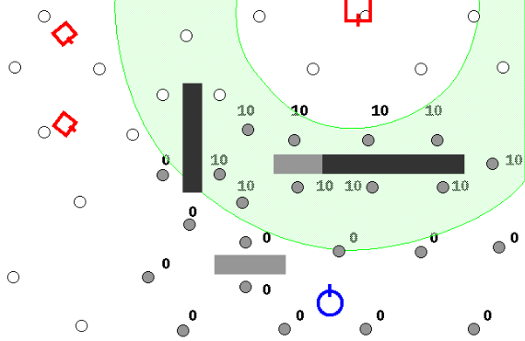
Example
a) Distance nearby points
b) Line-of-fire primary threat
c) Line-of-fire secondary threats
d) Preferred fighting range

Slide 20
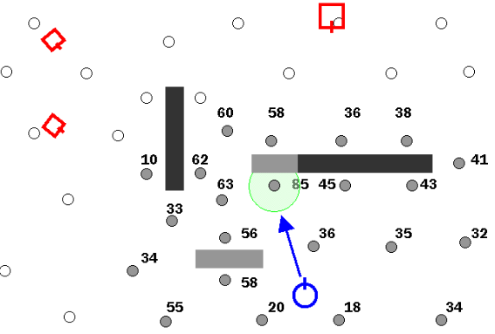
Example
e) Adding all annotations yields best position
Killzone's AI: dynamic procedural combat tactics

Slide 21
Overview
Introduction
Formation Motion
Waypoint Tactics
Tactical Analysis
Tactical Pathfinding
References

Slide 22
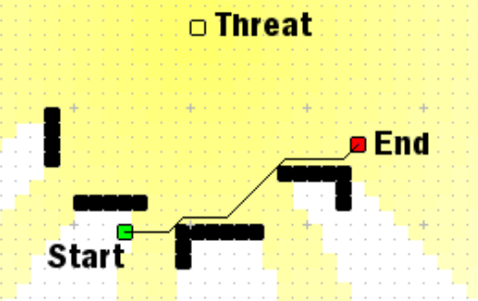
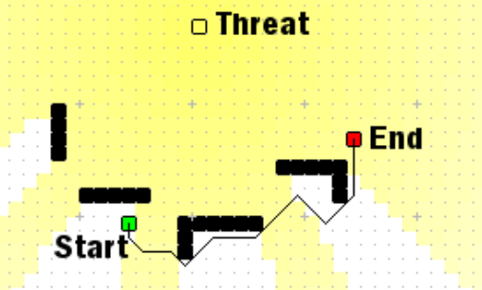

Tactical Pathfinding
Is shortest path the best path?
Connection cost function:
* Killzone's AI: dynamic procedural combat tactics

Slide 23
Overview
Introduction
Formation Motion
Waypoint Tactics
Tactical Analysis
Tactical Pathfinding
References

Slide 24
References
Straatman, van der Sterren & Beij. Killzone's AI: dynamic procedural combat tactics, 2005.
Ferdinand Joseph Fernandez. Influence Maps Unity 3d, Anomalous Underdog, 2012.
Ian Millington. AI for Games (3rd edition). CRC Press, 2019.
Ammobox Studios. FPS/RTS Tactical AI in Unreal Engine 4.0, 2014.
Soren Johnson. Playing to Lose: AI and "Civilization", 2010.
Damián Isla. Building a Better Battle: The Halo 3 AI Objectives System, audio, 2008.
Alex J. Champandard. The Core Mechanics of Influence Mapping, video, 2011.

